Slide 1
BBL Fantasy AI v2

Slide 2
New Additions
Pricing Model
Full Season Simulation Tool
Batting & Bowling Points Modelling (*)
Interval Modelling instead of Point Estimation
New Player Unsupervised Clustering Model to identify closest x amount of current bbl players and mimic predictions (Gen AI?)
Weather model/ alternative strategies based on rain out games

Slide 3
Remove rained out games
Rained out games provide very strange fantasy points behaviour which are not representative of the actual full game.
These games should be removed to not mask/ weaken relationships
Fix: removed all rain affected games from the modelling data
Add: Can look into method to predict prob of rain affected game

Slide 4
Added players who had no involvement
Currently only players who batted or bowled are directly added to the fantasy point table
This is no representative of the entire players fp
Fix: Identified missing players and appended with 0 points

Slide 5
Pricing Model
Three individual models
After 1 Game Expected Price Change Model
After 2 Games Expected Price Change Model
After 3 or more Games Expected Price Change Model

Slide 6
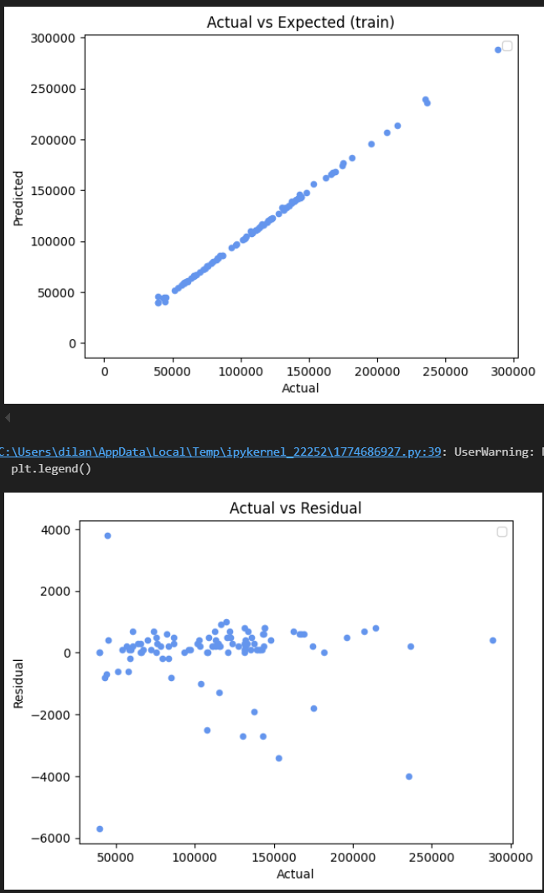
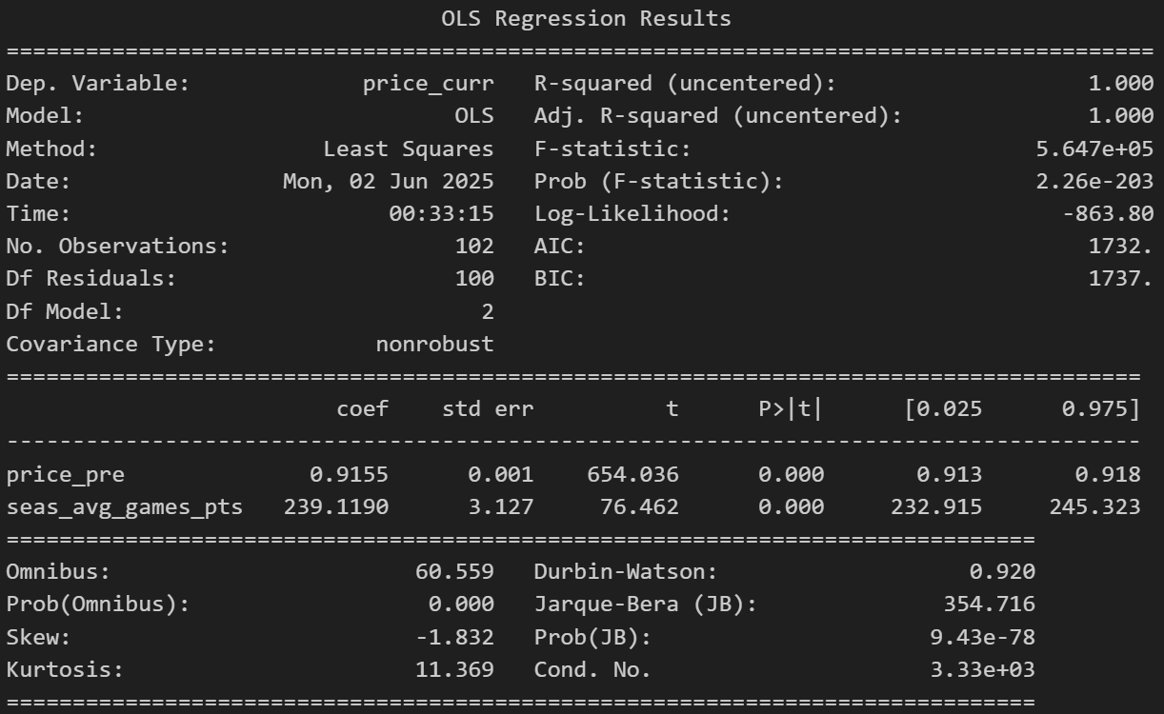

Pricing Model 1

Slide 7
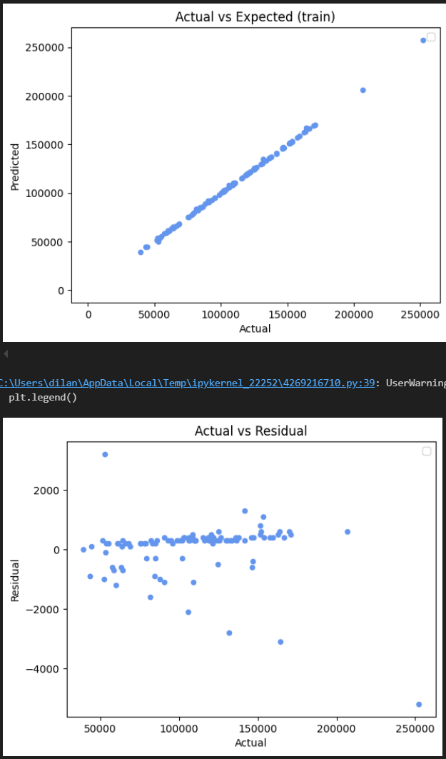
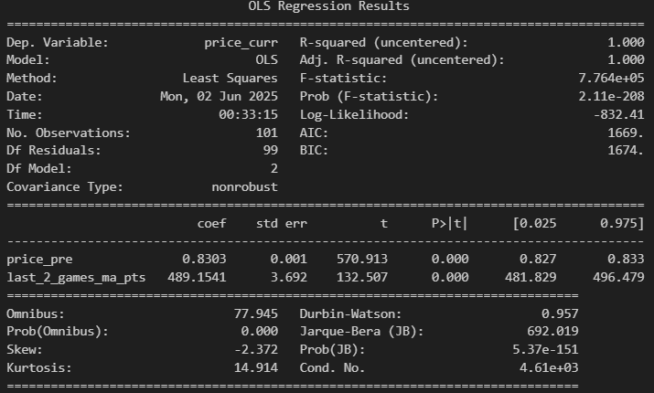

Pricing Model 2

Slide 8
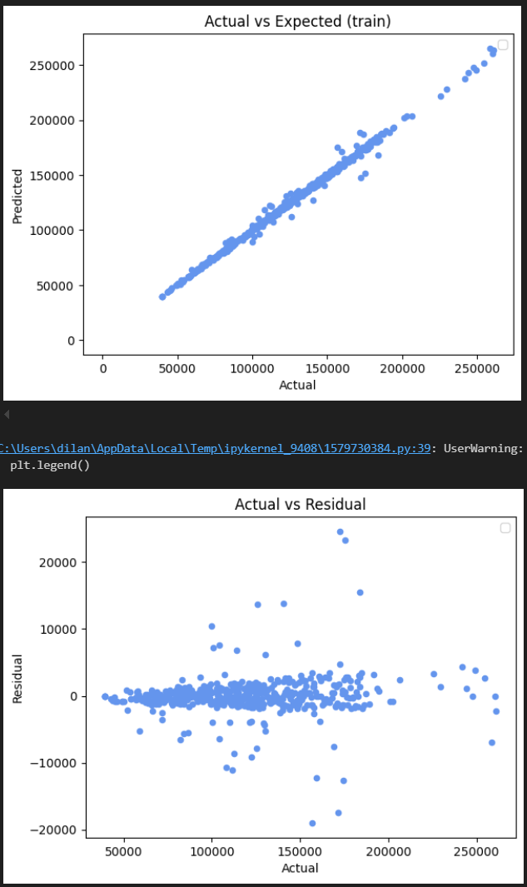
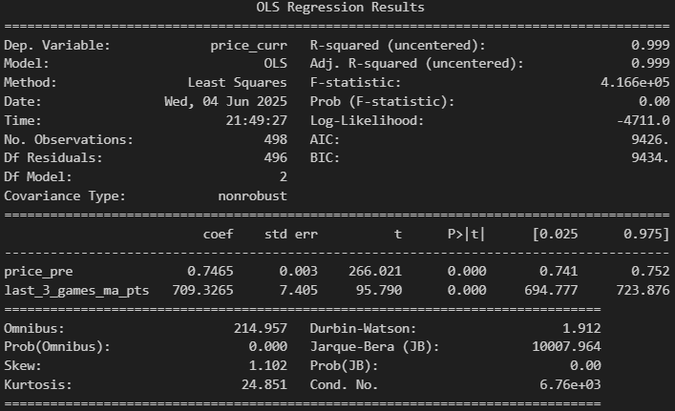

Pricing Model 3

Slide 9
Previous Features
Features
Player previous seasons fantasy points summary stats
Match opponent
Match venue
Home venue
Team Rank
Home Ground Advantage Interaction Term
During Tournament
Current season player fantasy points summary stats
Which overs bowled
Batting position

Slide 10
Batting Model
Additional Features:
Whether the player will bat feeder model
Player actual performance (average runs, average strike rate, average bowls faced etc)
Previous season batting points
Pre season form? Cricinfo/ other tournaments
Other tournaments flag (e.g. total number of t20 leagues played)
Number of games played compared max in team

Slide 11
Batting Model
Problem:
Currently can not identify the batting position of the players who do not bat in the game (truncated data) and therefore the current batting position flags are skewed
Solution: Two part model
Expected Batting points = Pr of batting model x Number of batting points given player bats

Slide 12
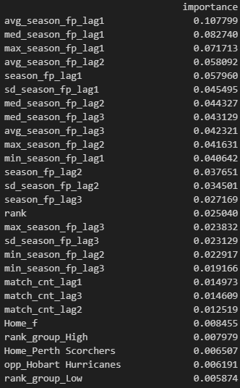
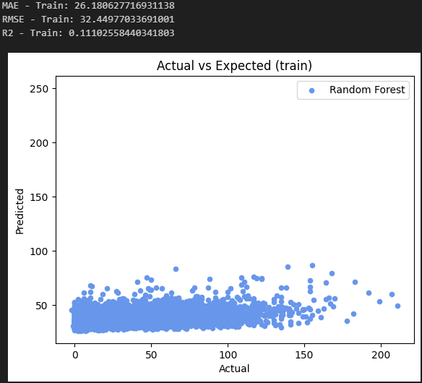
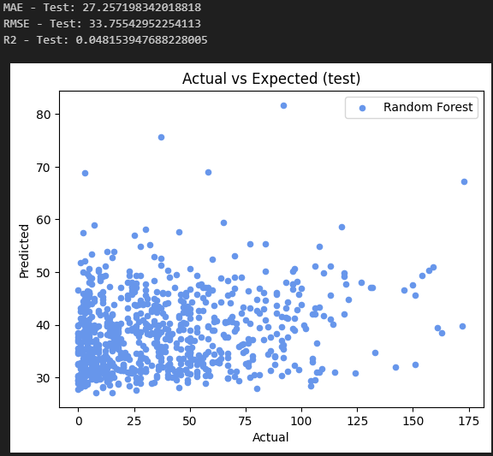
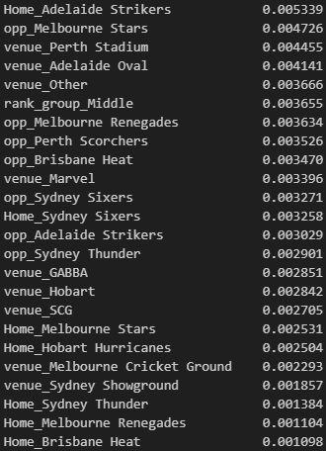
RF Model 1

Slide 13
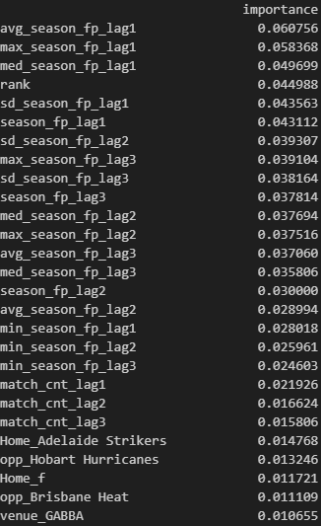
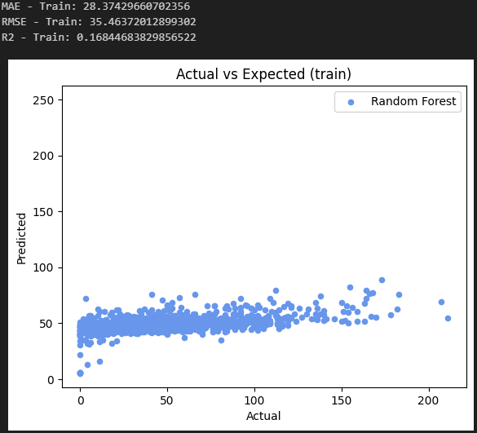
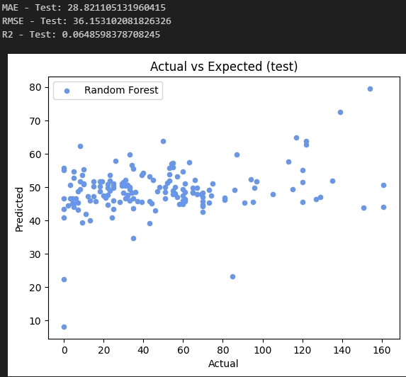
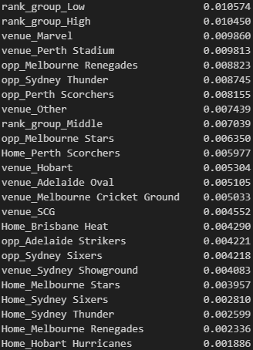
RF Model 2 – Incl 0 players

Slide 14
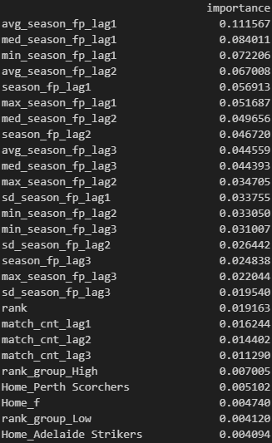
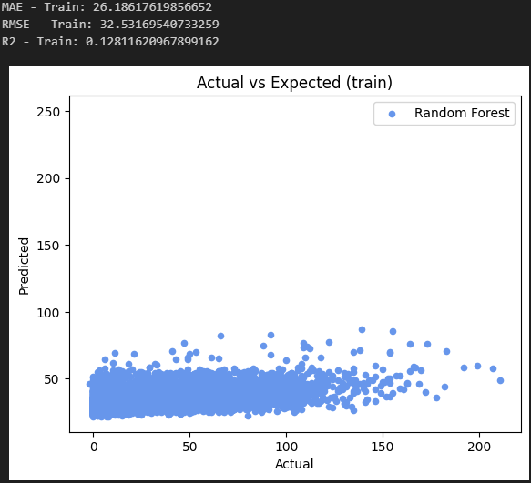
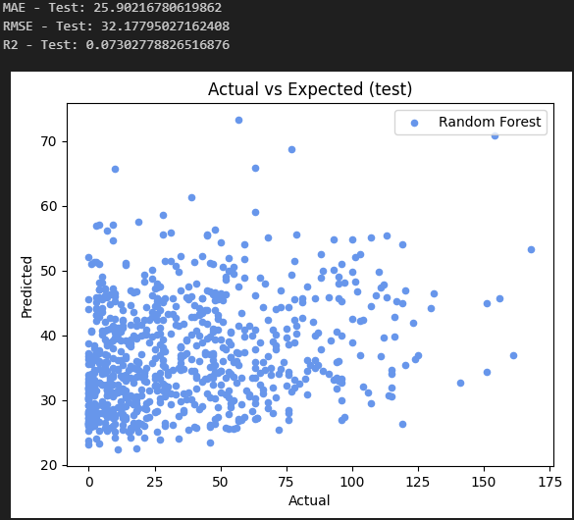
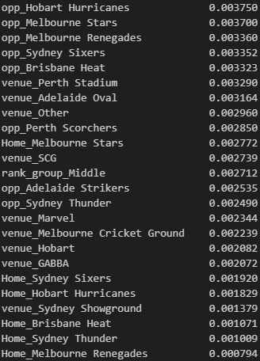
RF Model 3 – rm rain games

Slide 15
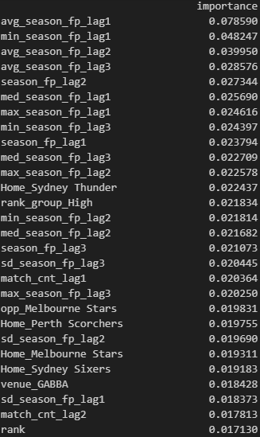
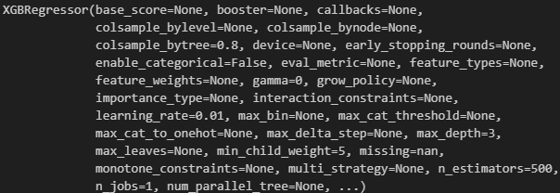
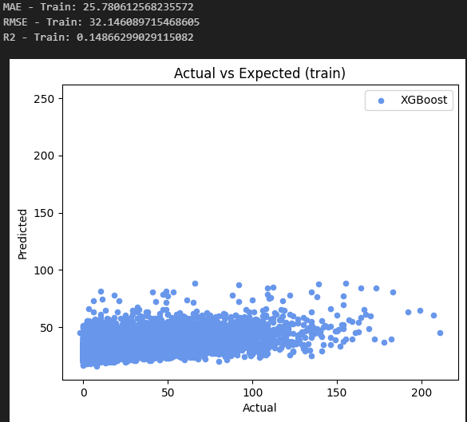
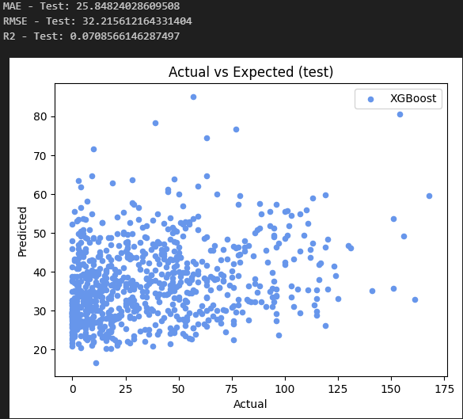
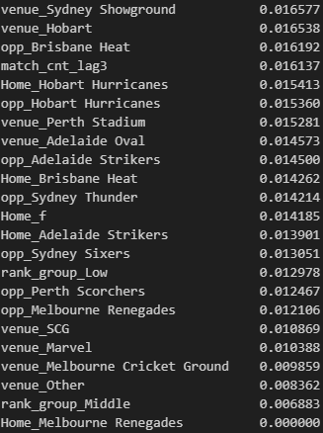
XGB Model 1

Slide 16
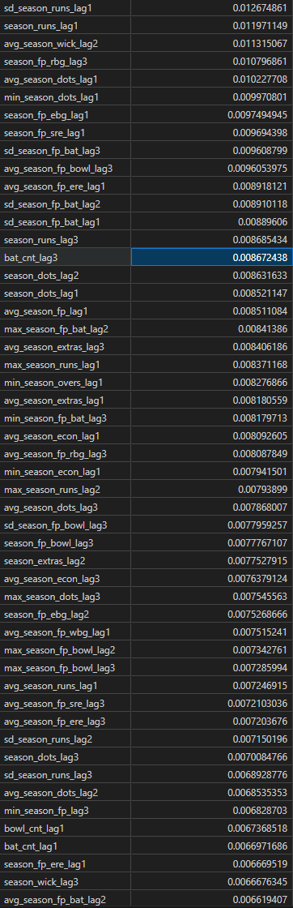
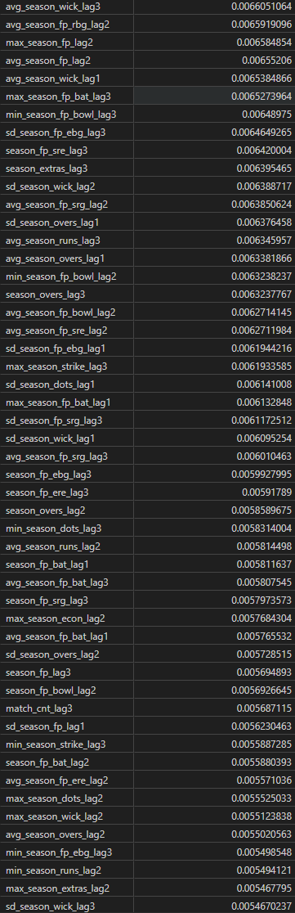
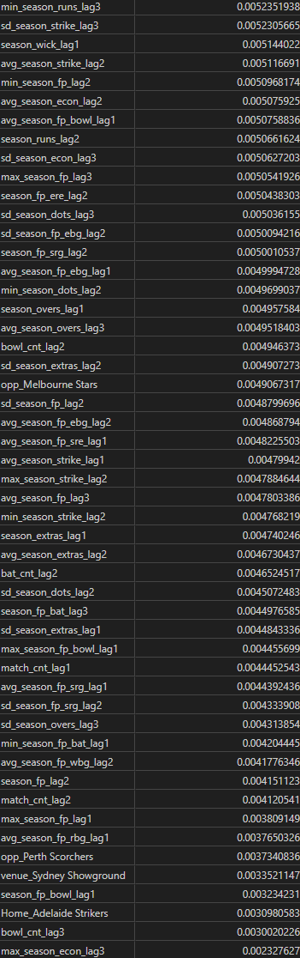
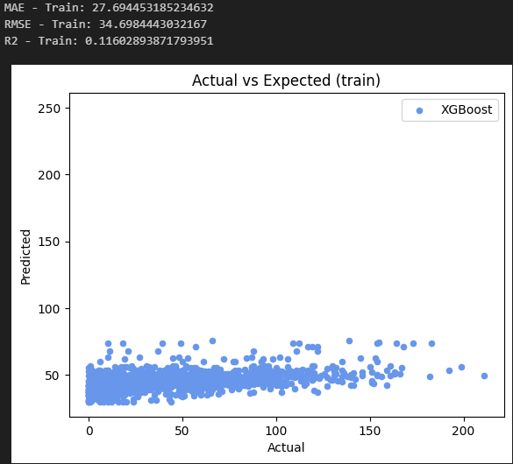
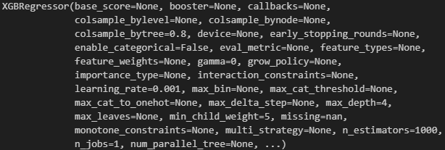
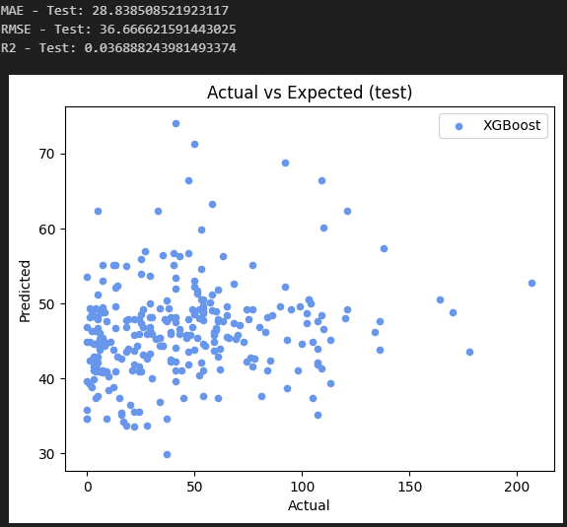
XGB Model 2

Slide 17
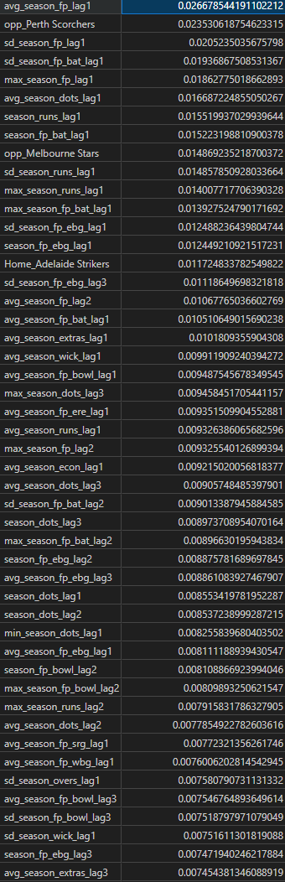
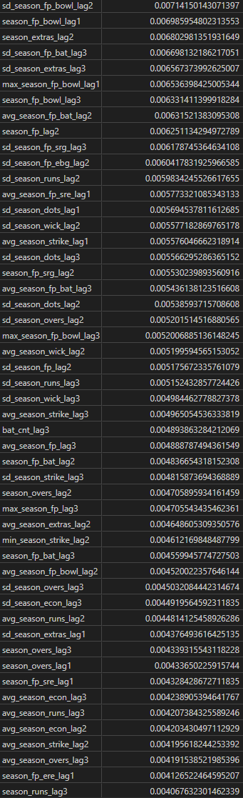
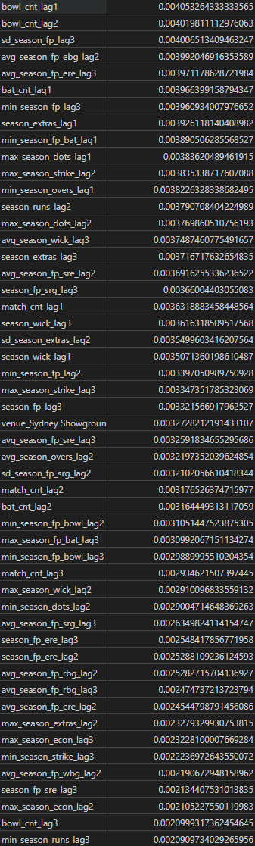
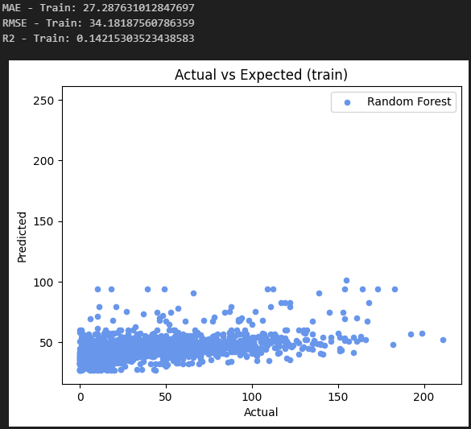
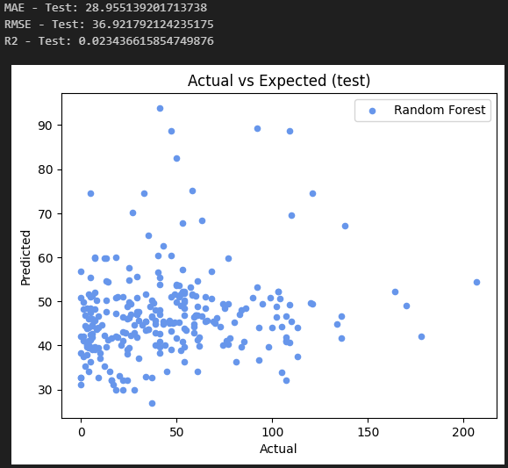
RF on same data

Slide 18
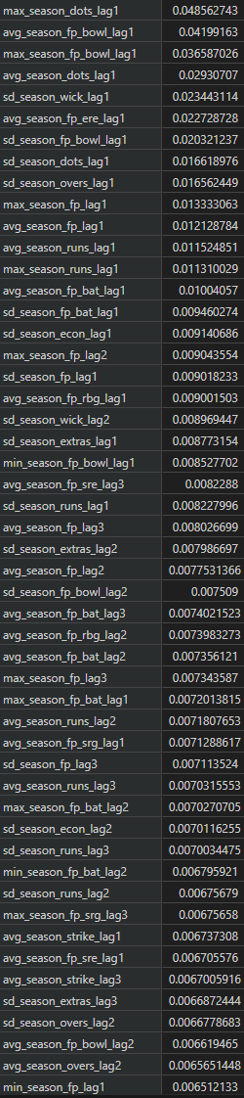
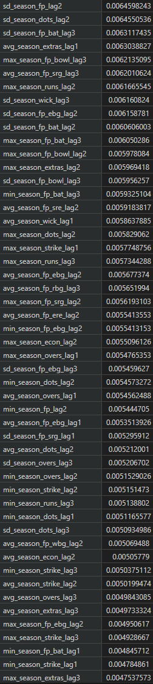
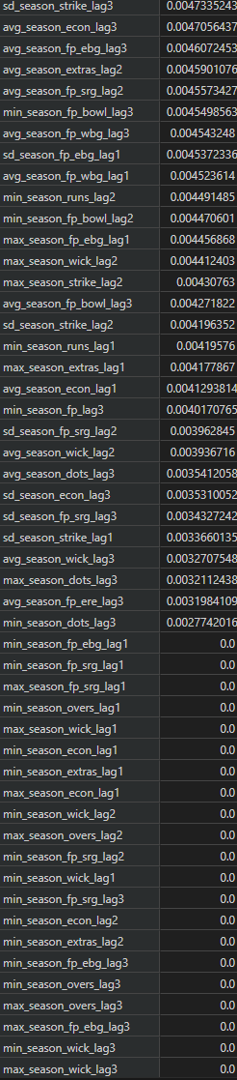

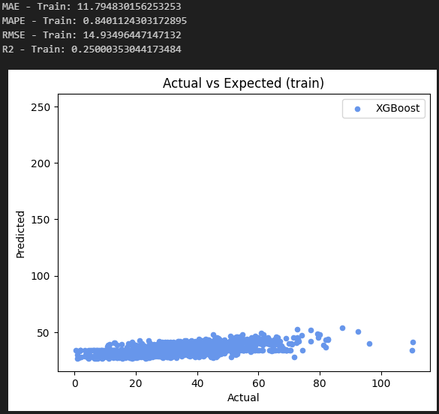

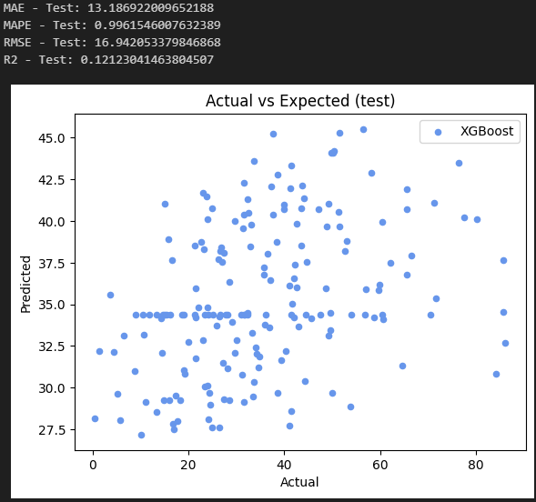
XGB Model 1

Slide 19
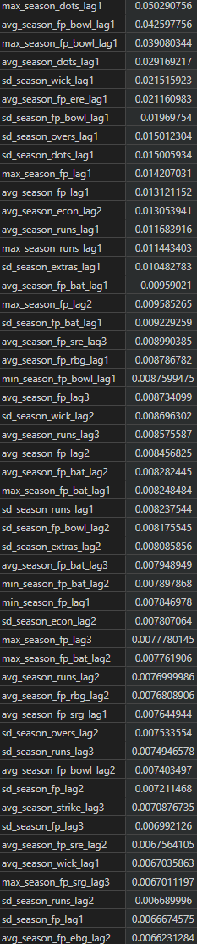
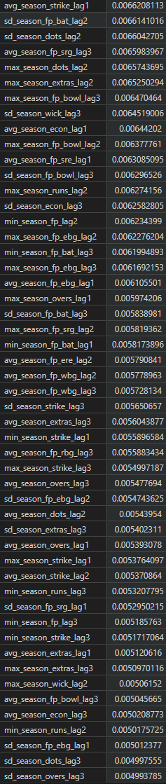
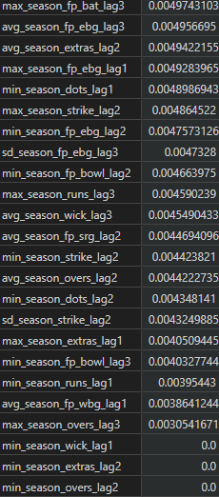
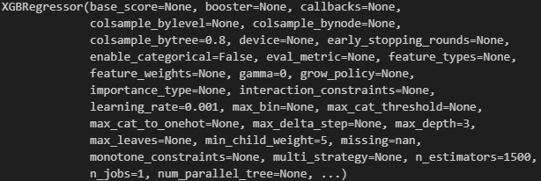
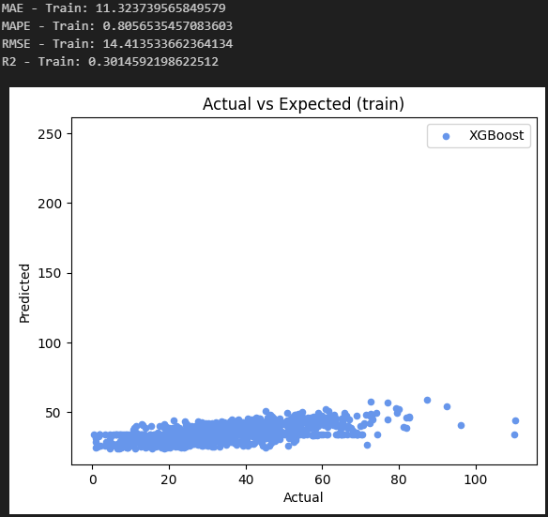
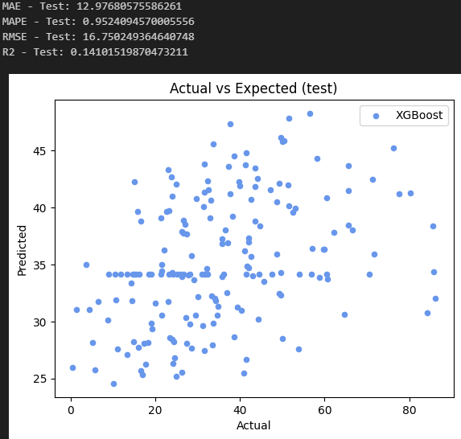
XGB Model 2

Slide 20
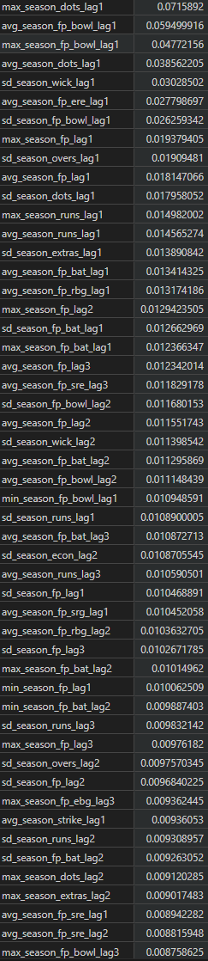
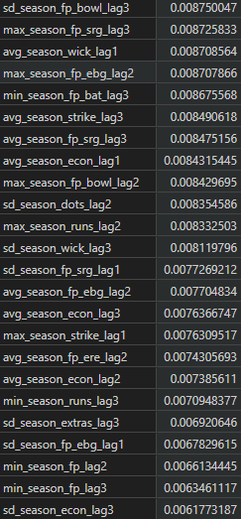
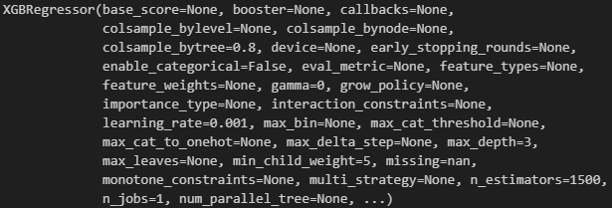
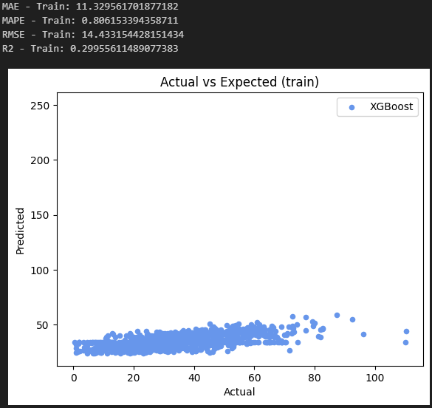
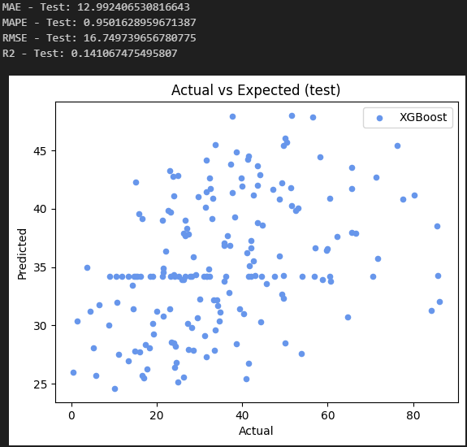
XGB Model 3

Slide 21




XGB Model 4

Slide 22





XGB Model 1

Slide 23




XGB Model 2

Slide 24




XGB Model 3

Slide 25




XGB Model 4 – HP Tuned

Slide 26
XGB Model 1

